Slide 1
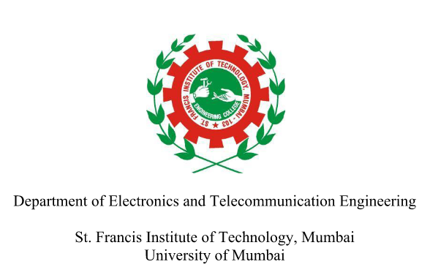
Password Based Smart Locking System
SEMIV MiniProject1B: Arduino & Raspberry Pi Projects
Mohd Aman – 28
Purva Shete – 34
Shreyash Tiwari – 43
Riddhesh Veling – 45
Guide
Ms. Savita Kulkarni

Slide 2
Introduction To Topic
A password based smart locking system is a type of access control system that allows users to enter passcode to gain entry to secure area.
The system typically consists of a locking mechanism, a control panel (Arduino) and user interface (Android Device).
The user enters their password and if it is correct, the locking mechanism is disengaged and the user is granted access.
Password – based smart locking system can provide a high level of security, as long as password is kept confidential.
This type of locking system is used in homes, offices and other areas where access is given to authorized individual.

Slide 3
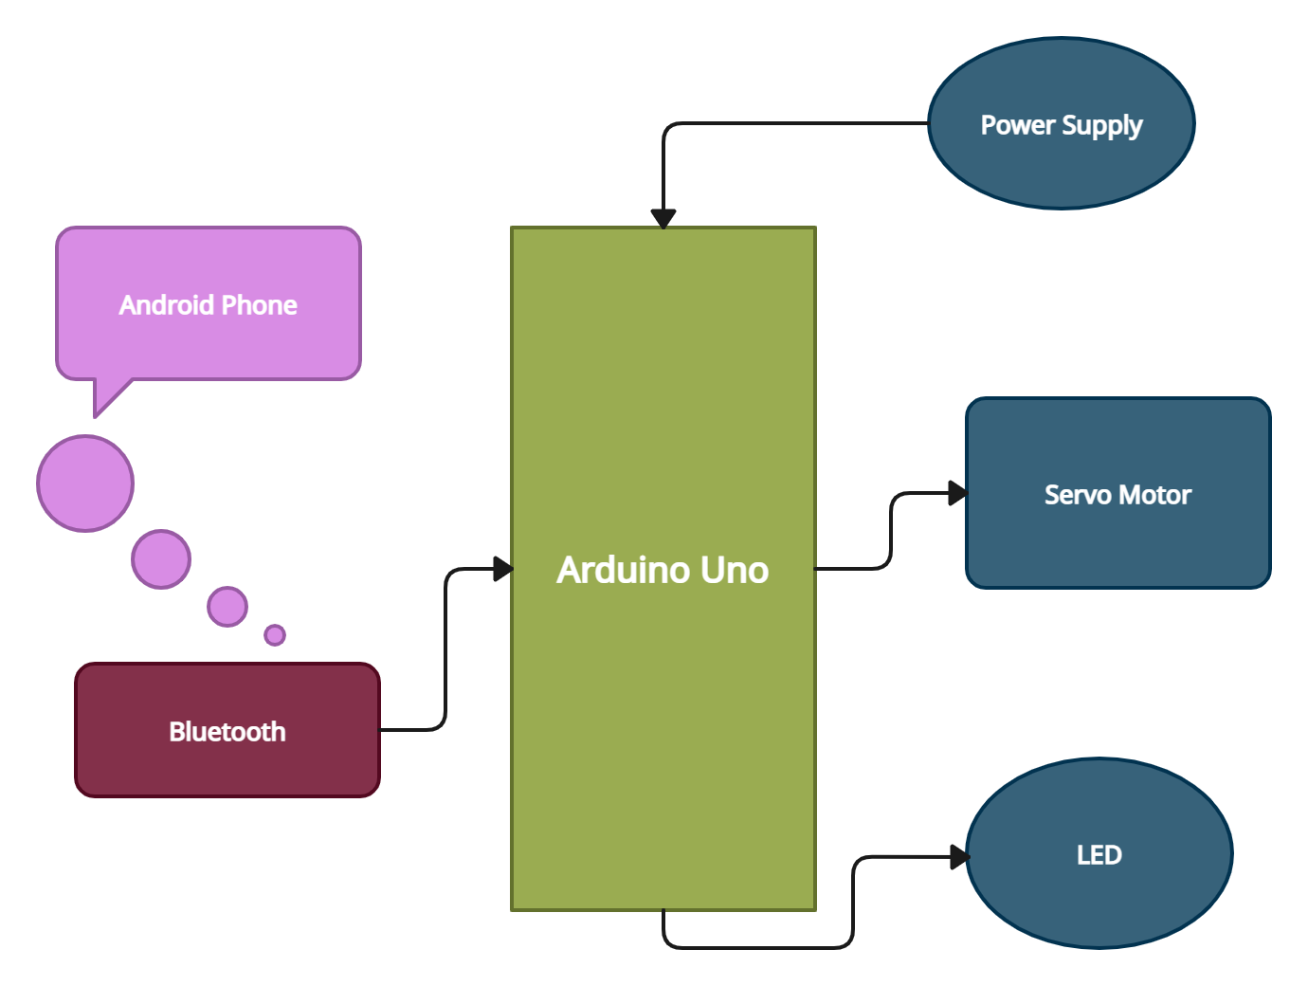
Block Diagram

Slide 4
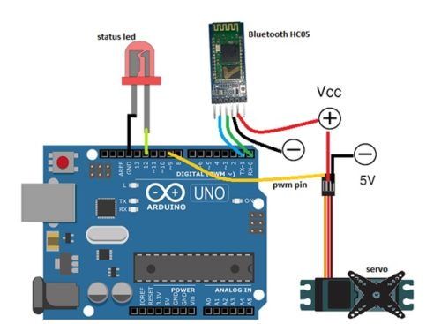
Circuit Diagram with Arduino

Slide 5
Hardware Components & Specifications
The components used are :-
Arduino UNO
Bluetooth HC05
Servo Motor
LED
Wires
5V Battery
USB Type-B for Arduino programming

Slide 6
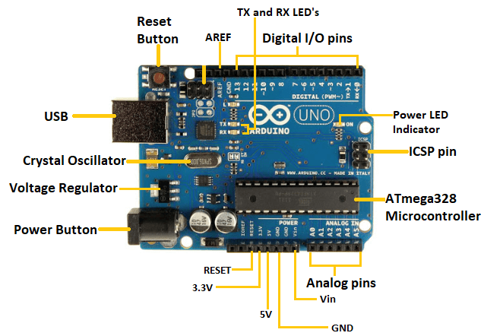
Hardware Components & Specifications
1) Arduino Uno :

Slide 7
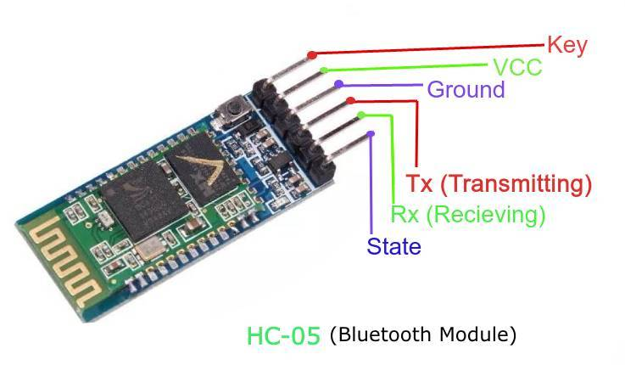
Hardware Components & Specifications
2) Bluetooth HC05 :
Designed to replace cable connections HC-05 uses serial communication to communicate with the electronics. Usually, it is used to connect small devices like mobile phones using a short-range wireless connection to exchange files. It uses the 2.45GHz frequency band.
1. Key: It is used to bring Bluetooth module in AT commands mode. If Key/EN pin is set to high, then this module will work in command mode. Otherwise by default it is in data mode. The default baud rate of HC-05 in command mode is 38400bps and 9600 in data mode.
HC-05 module has two modes,
1. Data mode: Exchange of data between devices.
2. Command mode: It uses AT commands which are used to change setting of HC-05. 2. VCC: Connect 5 V or 3.3 V to this Pin.
3. GND: Ground Pin of module.
4. TXD: Transmit Serial data (wirelessly received data by Bluetooth module transmitted out serially on TXD pin)
5. RXD: Receive data serially (received data will be transmitted wirelessly by Bluetooth module).
6. State: It tells whether module is connected or not.

Slide 8
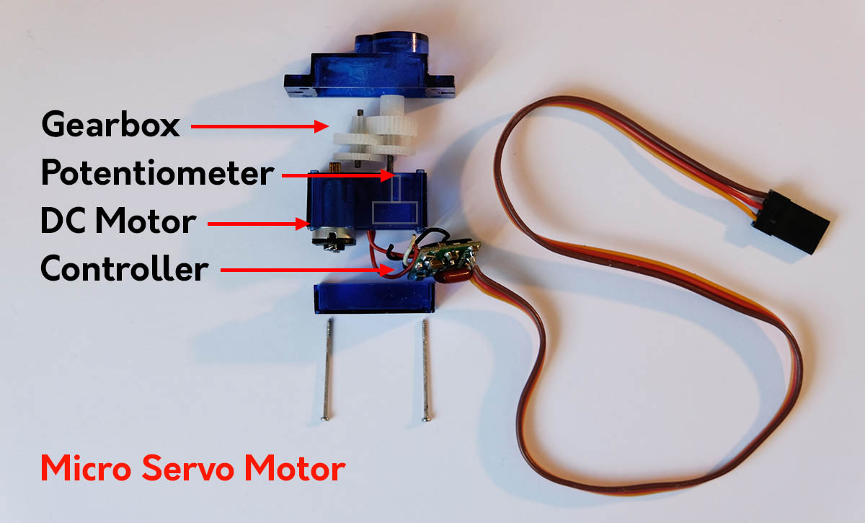
Hardware Components & Specifications
3) Mini Servo Motor :
A servo motor is controlled by controlling its position using Pulse Width Modulation Technique. The width of the pulse applied to the motor is varied and send for a fixed amount of time.
The pulse width determines the angular position of the servo motor. For example, a pulse width of 1 ms causes an angular position of 0 degrees, whereas a pulse width of 2 ms causes an angular width of 180 degrees.

Slide 9
Circuit Operation
We need to write the Arduino code first for locking and unlocking of the door. For that we need to include the required library files. As we have used servo motor for locking and unlocking, we have included servo.h library.
For making the user interface of locking and unlocking, we create a mobile app using the MIT(Massachusetts Institute of Technology) App Inventor.
The user interface is divided into 2 screens. The first screen is the ‘login page’ where the user needs to put correct password. The second screen is ‘control page’ where user can access the lock.
On the control page, when the user first needs to connect the phone’s Bluetooth to HC-05 module’s Bluetooth.
On pressing lock button the status LED turns red and the servo is set to lock position and vice versa.

Slide 10
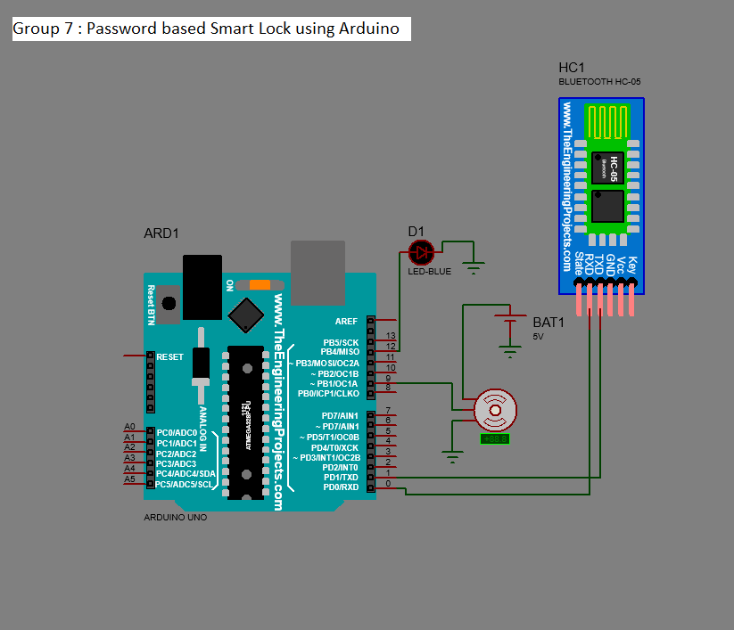
Schematic Diagram

Slide 11
Steps Of Operation
Turn on your phone’s Bluetooth so that it is discoverable by HC-05 module.
Open the ‘Smart Security’ app installed in your Android phone.
Enter the correct password to access the lock control screen.
Press the Bluetooth icon to scan the nearby and previously connected devices.
Select the Bluetooth address with name ‘HC-05’.
The Bluetooth status will show whether the device is successfully paired with HC-05.
Now press on ‘Unlock Button’(green colour) to unlock the door lock.
To lock the door again, press the ‘Lock Button’(red colour).
Once the required operation is done, close the app.

Slide 12
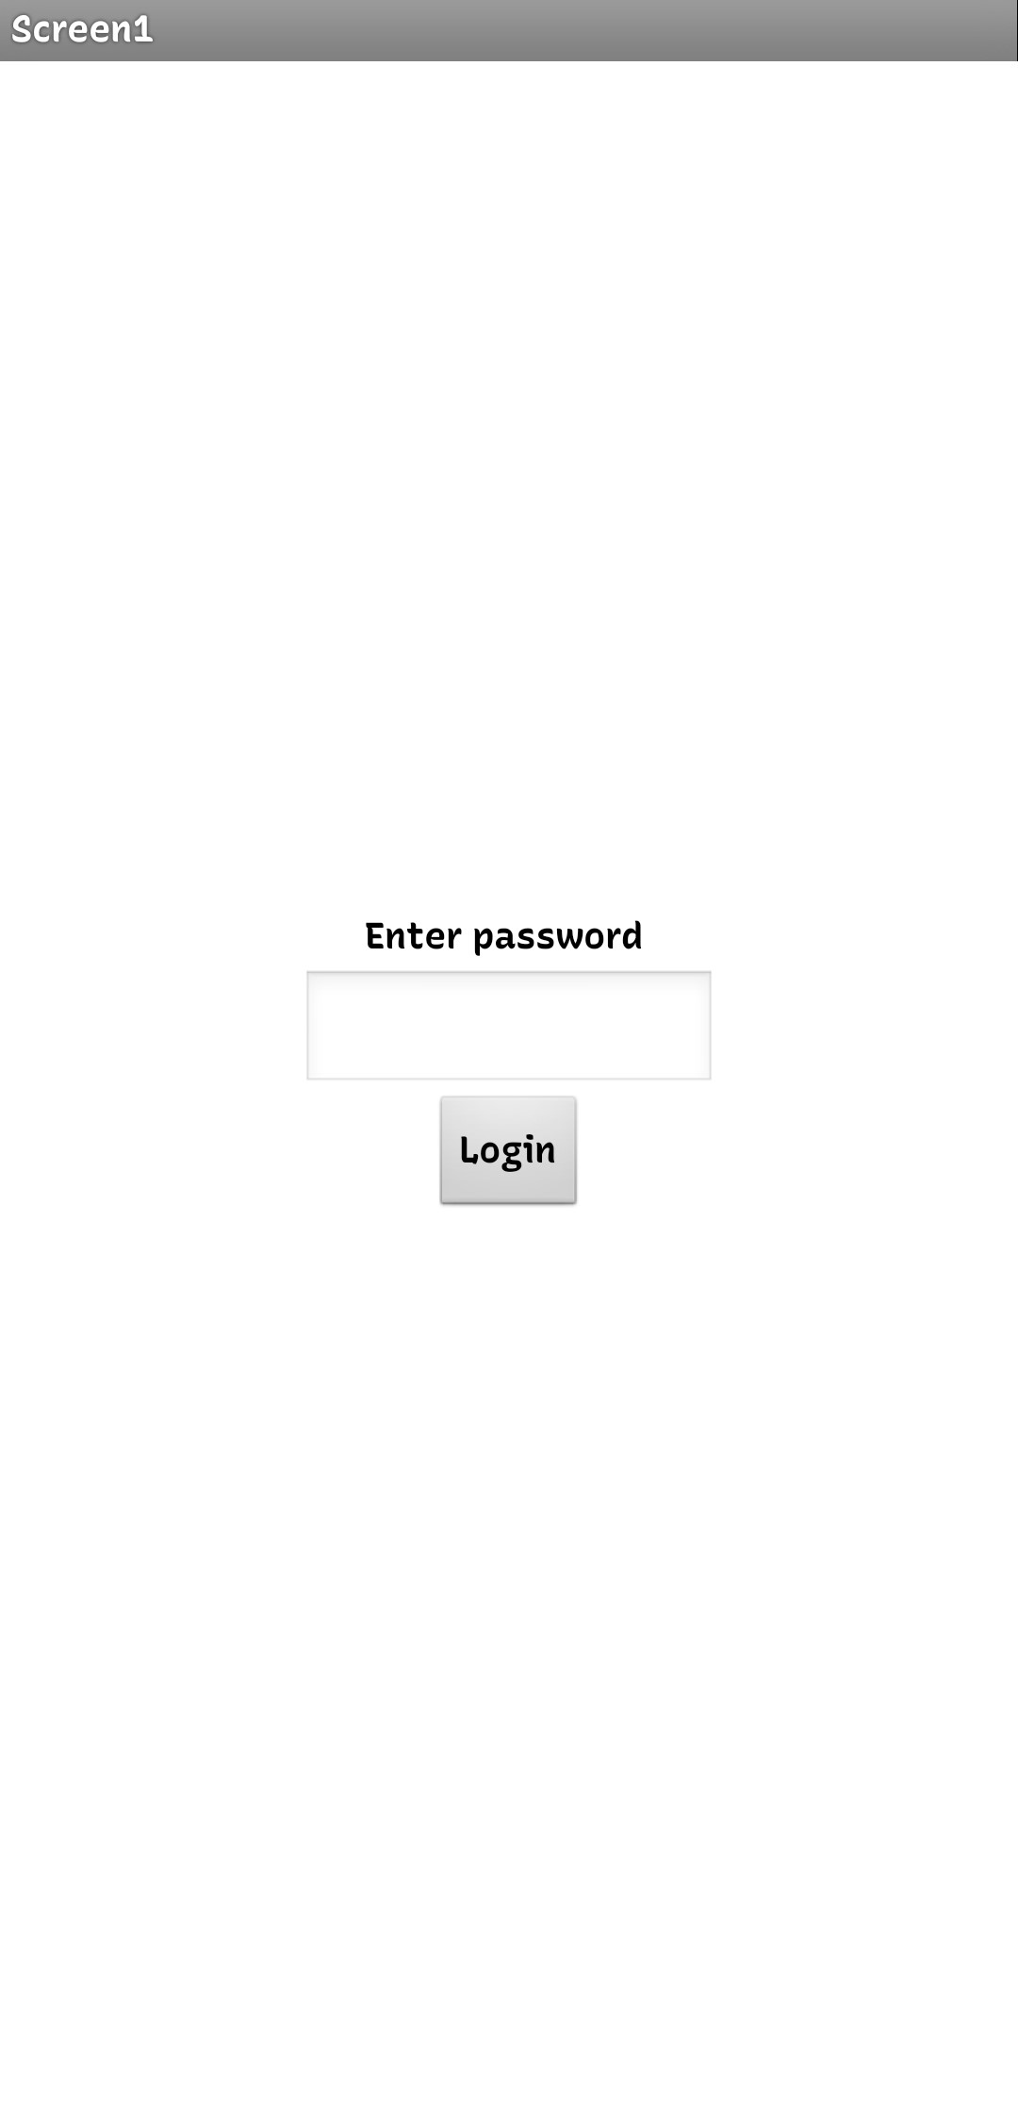
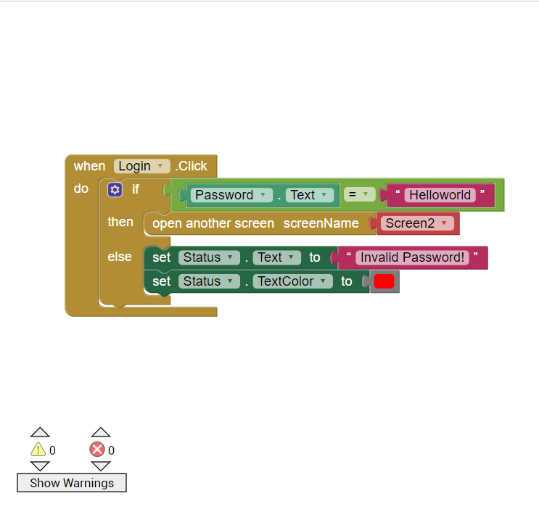
Results
Login Page UI
MIT App Inventor Code

Slide 13
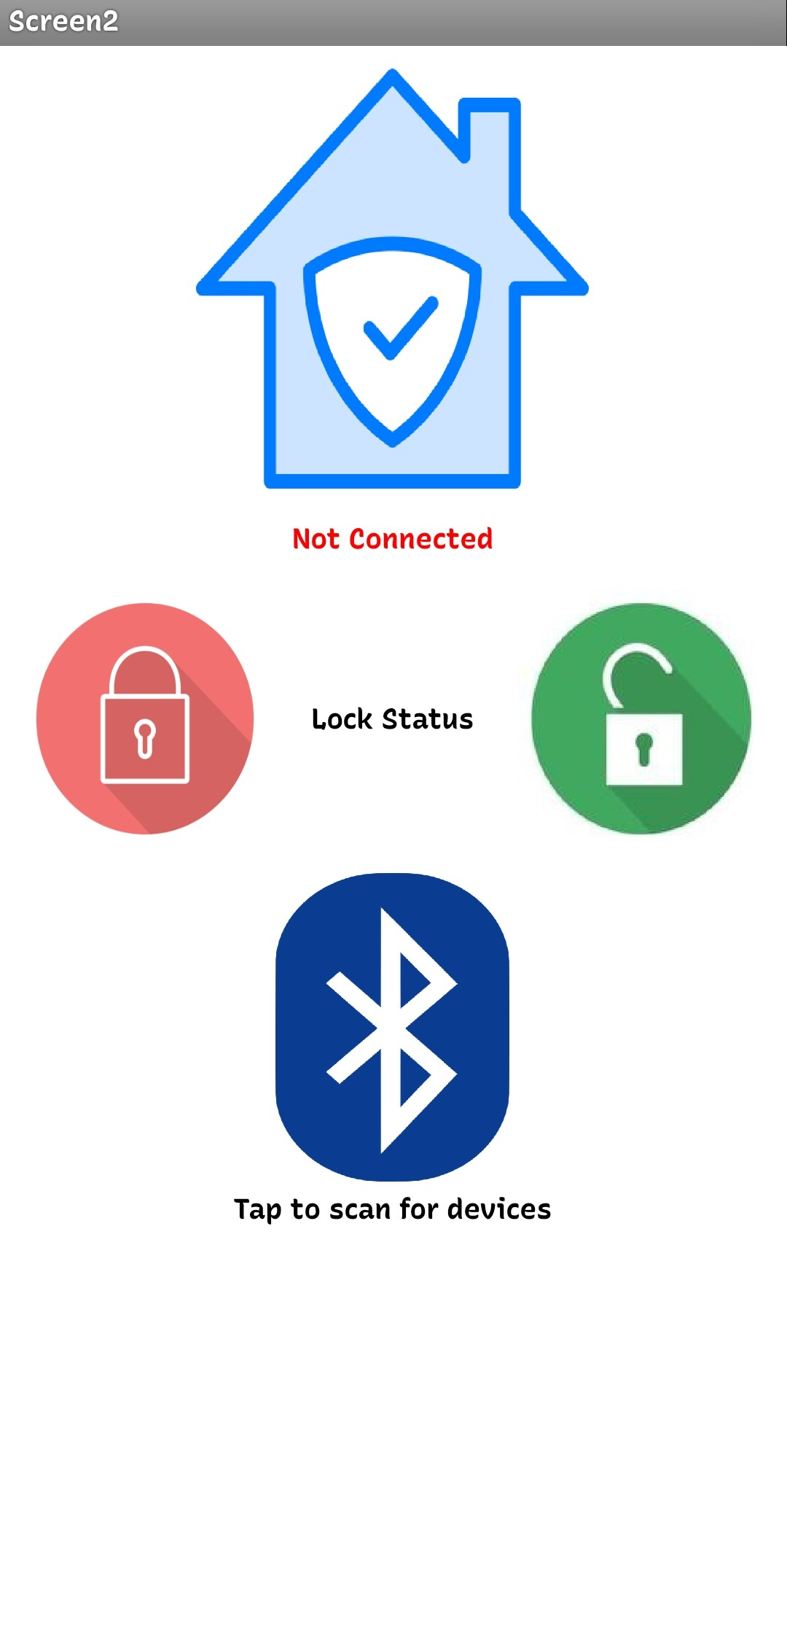
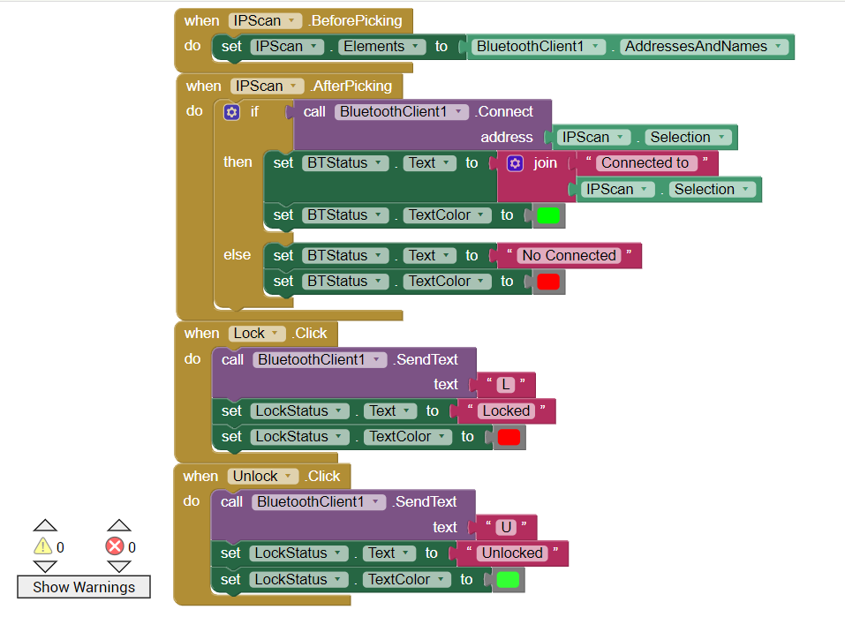
Results
Control Page UI
MIT App Inventor Code

Slide 14
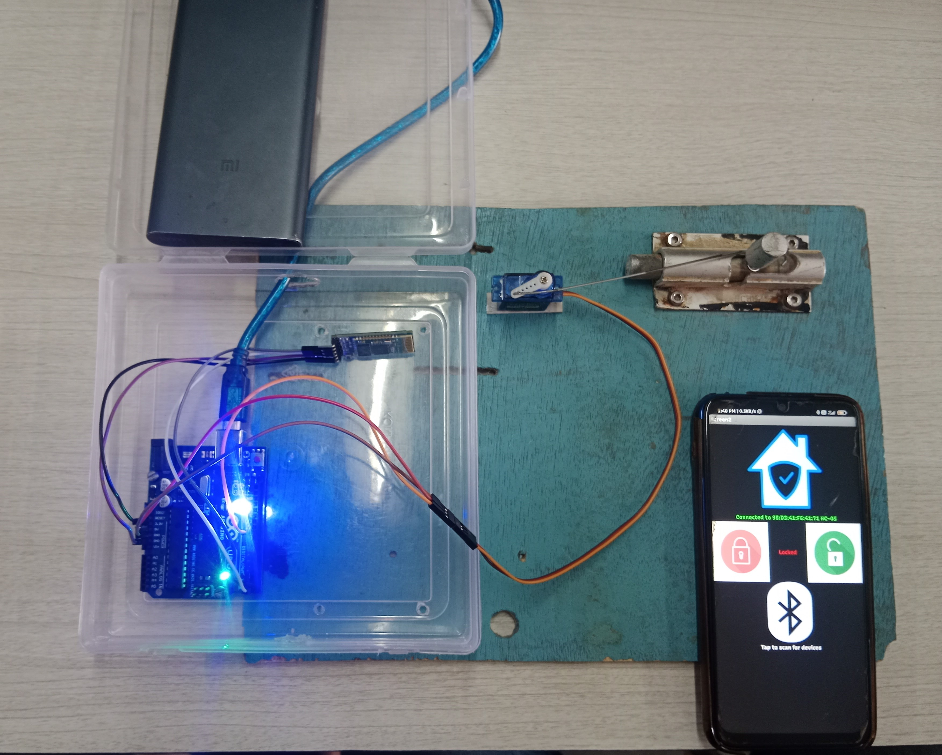
Results
When Lock button is pressed

Slide 15
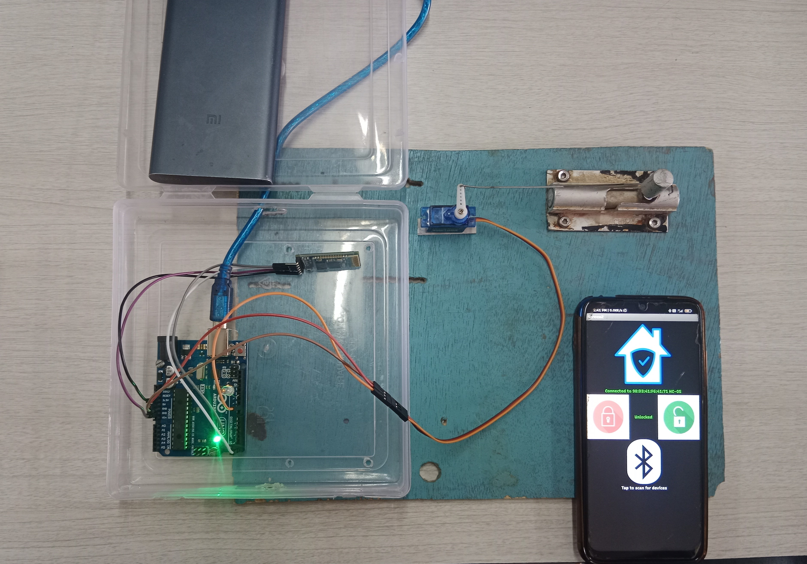
Results
When Unlock button is pressed

Slide 16
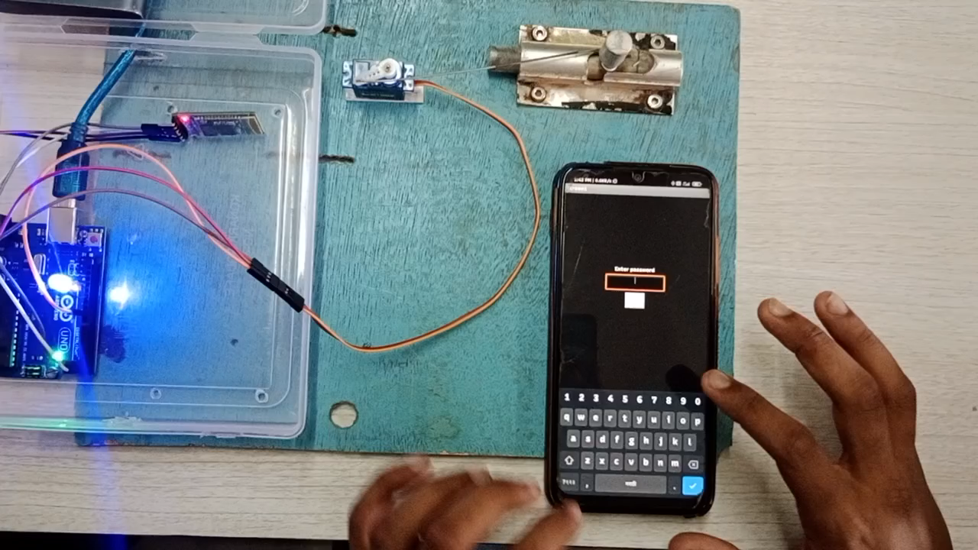
Results
Smart Lock working video

Slide 17
Troubleshooting
The original project was based on OTP that the user will receive and then use it to unlock the door lock. But, we were unable to send the produced OTP to the user screen.
To tackle this problem, we changed the idea of OTP to login password which would work the same way.

Slide 18
Advantages
Convenience: With a Bluetooth-enabled smart door locking system, you can control the lock using your mobile phone without the need for an internet connection, making it easier to lock and unlock your door.
Customization: Using the Arduino Uno, you can customize the smart lock to meet your specific needs, such as setting automatic lock and unlock times, creating temporary access passwords for guests, and much more.
Multiple User Access: With a smart lock, you can grant access to multiple users, such as family members or trusted friends, by providing them with a unique access code or virtual key.
Easy Installation: A smart door locking system using Arduino Uno can be easily installed by anyone with basic knowledge of electronics and programming, without the need for professional installation services.

Slide 19
Disadvantages
Limited Range: Bluetooth technology has a limited range, which means you need to be within a certain distance from the door to control it. This can be a disadvantage if you want to control the lock from a longer distance.
Compatibility Issues: The Bluetooth connectivity between the mobile device and the lock may have compatibility issues with some smartphones, which can limit the functionality of the smart lock system.
Security Risks: While Bluetooth technology is generally secure, there is still a risk of hacking and unauthorized access to the smart lock system. This can be a disadvantage if the system is not properly secured.

Slide 20
Application
Residential Use: A smart door locking system can be used in residential homes as a replacement for traditional keys, allowing homeowners to control their locks from their smartphones.
Rental Properties: A smart lock system can be used in rental properties, allowing landlords to remotely grant access to tenants or guests and monitor their comings and goings.
Healthcare: A smart lock system can be used in healthcare facilities to control access to restricted areas, such as medication storage rooms or patient records.
Parking Lots: Smart door locking systems can be used in parking lots to restrict access to certain areas, such as employee parking or restricted areas. The mobile app can be used to grant access to authorized personnel.

Slide 21
CONCLUSION
Many times we forget to carry the house keys or sometimes we get out of the house and end up locking ourselves out as the latch closes inadvertently. In these cases it really is difficult to get inside the house. This project will help in keyless entry and providing better security at the same time. This idea also minimizes the overall cost by the use of Bluetooth.

Slide 22
Future Scope
Hospitality industry: Smart door locks can be used in the hospitality industry to provide guests with a seamless and secure check-in and check-out experience. Arduino UNO can be used to create low-cost, customizable smart locks that can be programmed for individual guests.
Gym and fitness centers: Smart door locks can be used in gym and fitness centers to provide secure access control to members. Arduino UNO can be used to create low-cost, energy-efficient smart locks that can be easily integrated with existing fitness center systems.
Self-storage units: Smart door locks can be used in self-storage units to provide secure, remote access control to customers. Arduino UNO can be used to create low-cost, energy-efficient smart locks that can be easily integrated with existing self-storage systems.

Slide 23
Introduction
Ultrasonic distance sensor with raspberry pi is a popular way to create wide range of distance measurement and monitoring system.
The basic setup involves ultrasonic sensor, raspberry pi and software to control and process distance measurements.
The user enters their password and if it is correct, the locking mechanism is disengaged and the user is granted access.
Password – based smart locking system can provide a high level of security, as long as password is kept confidential.
This type of locking system is used in homes, offices and other areas where access is given to authorized individual.

Slide 24
Block Diagram
TRANSMITTED WAVE
TX
uC
LED DISPLAY
RX
RFLECTED WAVE
OBSTACLE
ULTARSONIC
SENSOR
RASPBERRY PI
PICO W

Slide 25
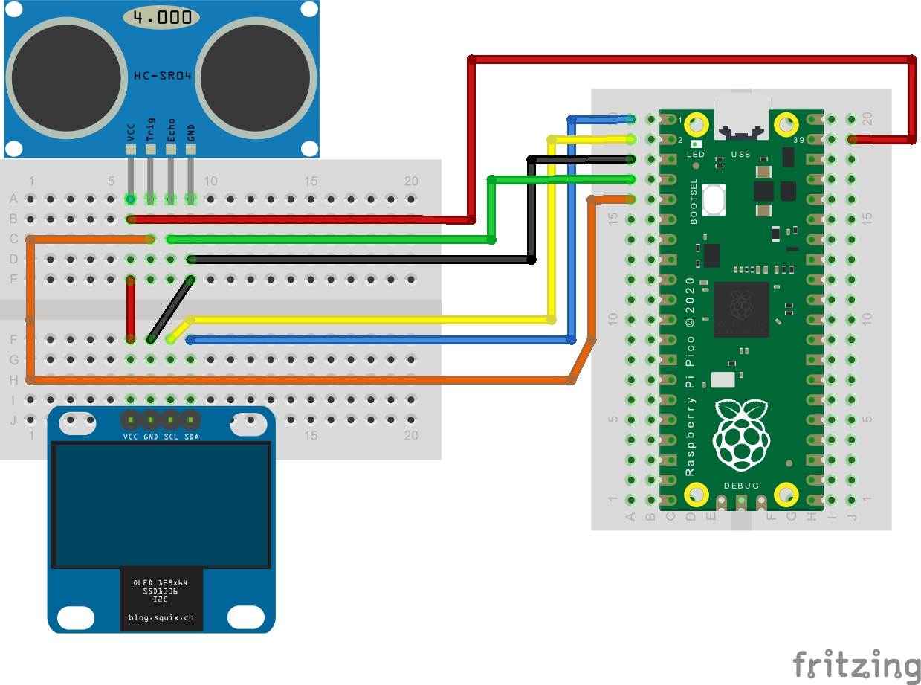
Circuit Diagram with RPi

Slide 26
Hardware Components & Specifications
The components used are :-
Raspberry Pi Pico W
SSD1306 OLED Display
Ultrasonic Sensor HC-SR04
Breadboard
Micro USB Cable

Slide 27
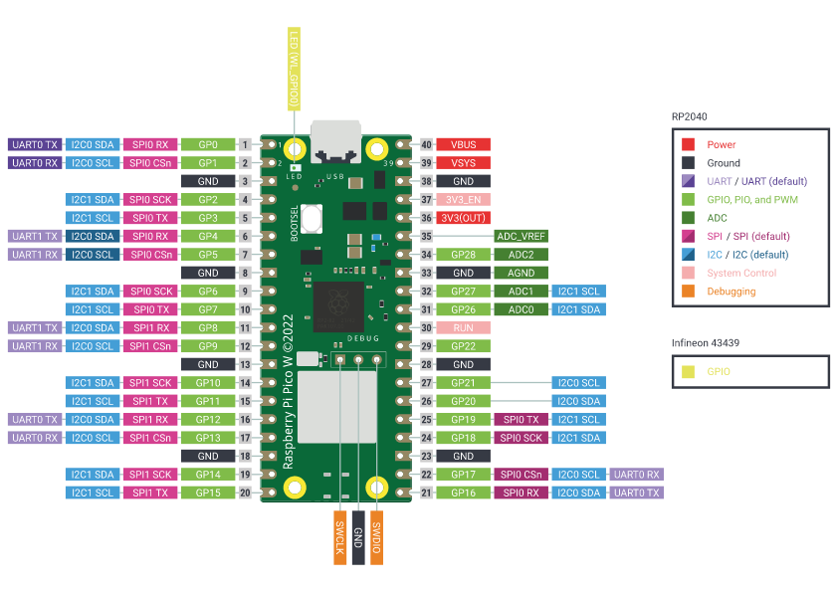
Hardware Components & Specifications
1) Raspberry Pi Pico W :

Slide 28
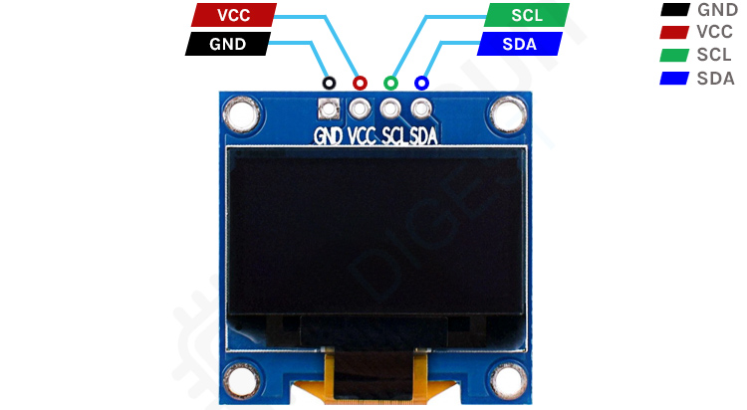
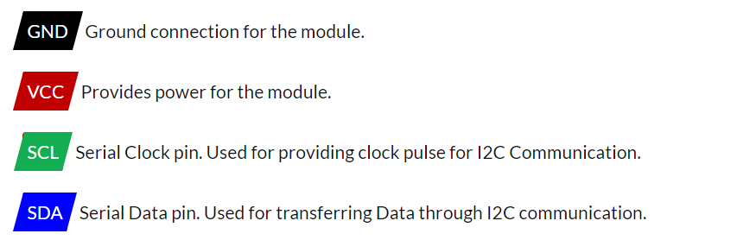
Hardware Components & Specifications
1) SSD1306 OLED Display :

Slide 29
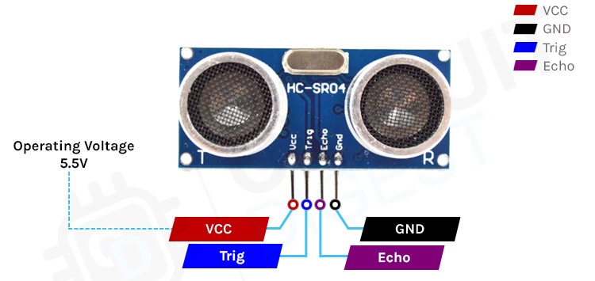
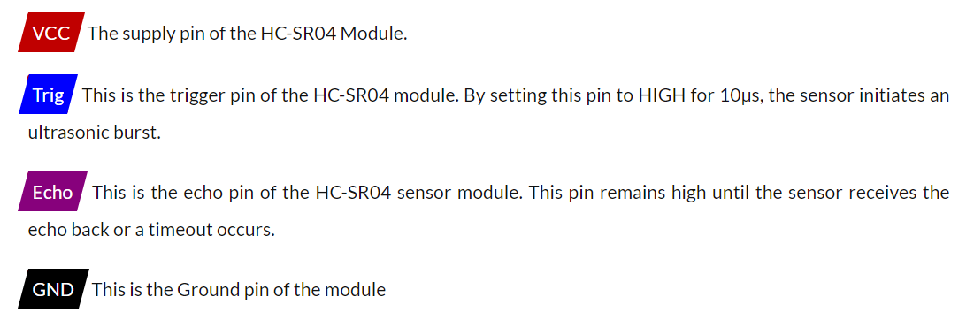
Hardware Components & Specifications
1) Ultrasonic Sensor HC-SR04 :

Slide 30
Circuit Operation
The HC-SR04 ultrasonic distance sensor used here works by emitting ultrasonic waves and measuring the time it takes for the waves to bounce back after hitting an object.
This time can be used to calculate the distance to the object using the formula:
distance = speed of sound × time / 2
The HC-SR04 sensor is then connected with a Raspberry Pi Pico, it can be connected to the Pi's GPIO pins.
We interfaced micropython into RPi Pico and then transferred the main code into Pico through Thonny IDE.
The calculated distance between the sensor and object is then shown on SSD1306 OLED Display through RPi Pico.
(The measured distance is in cm)

Slide 31
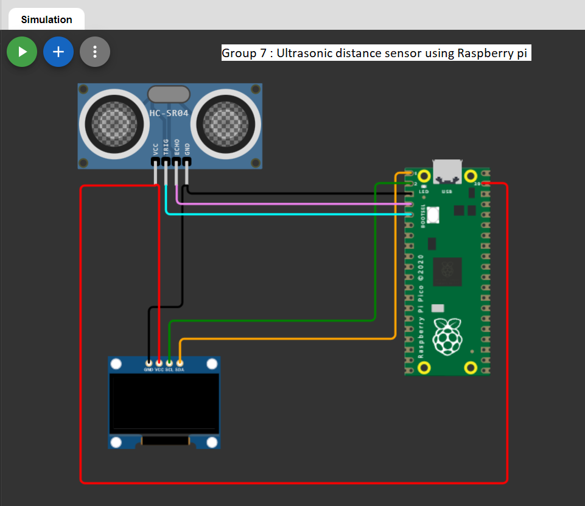
Schematic Diagram
Simulation link : https://wokwi.com/projects/358739137914121217

Slide 32
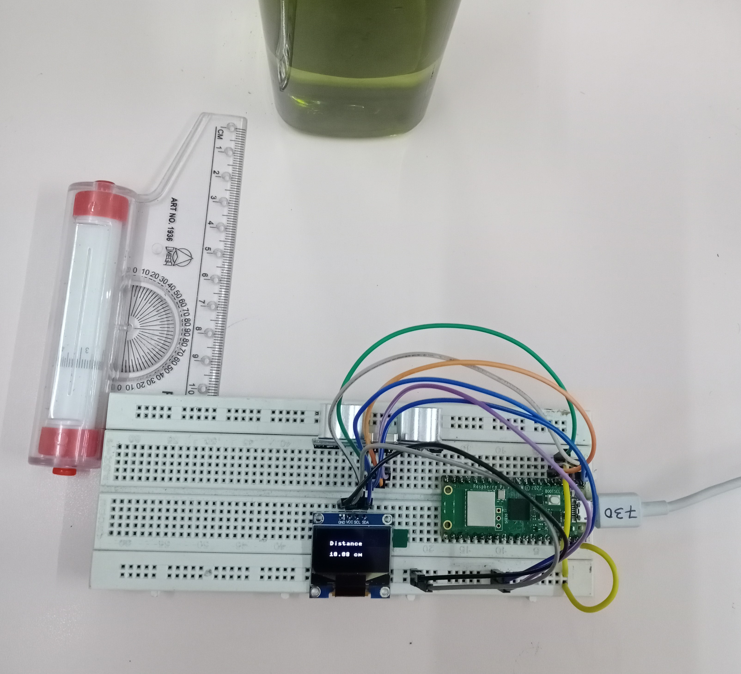
Results
Object at a distance of 10cm

Slide 33
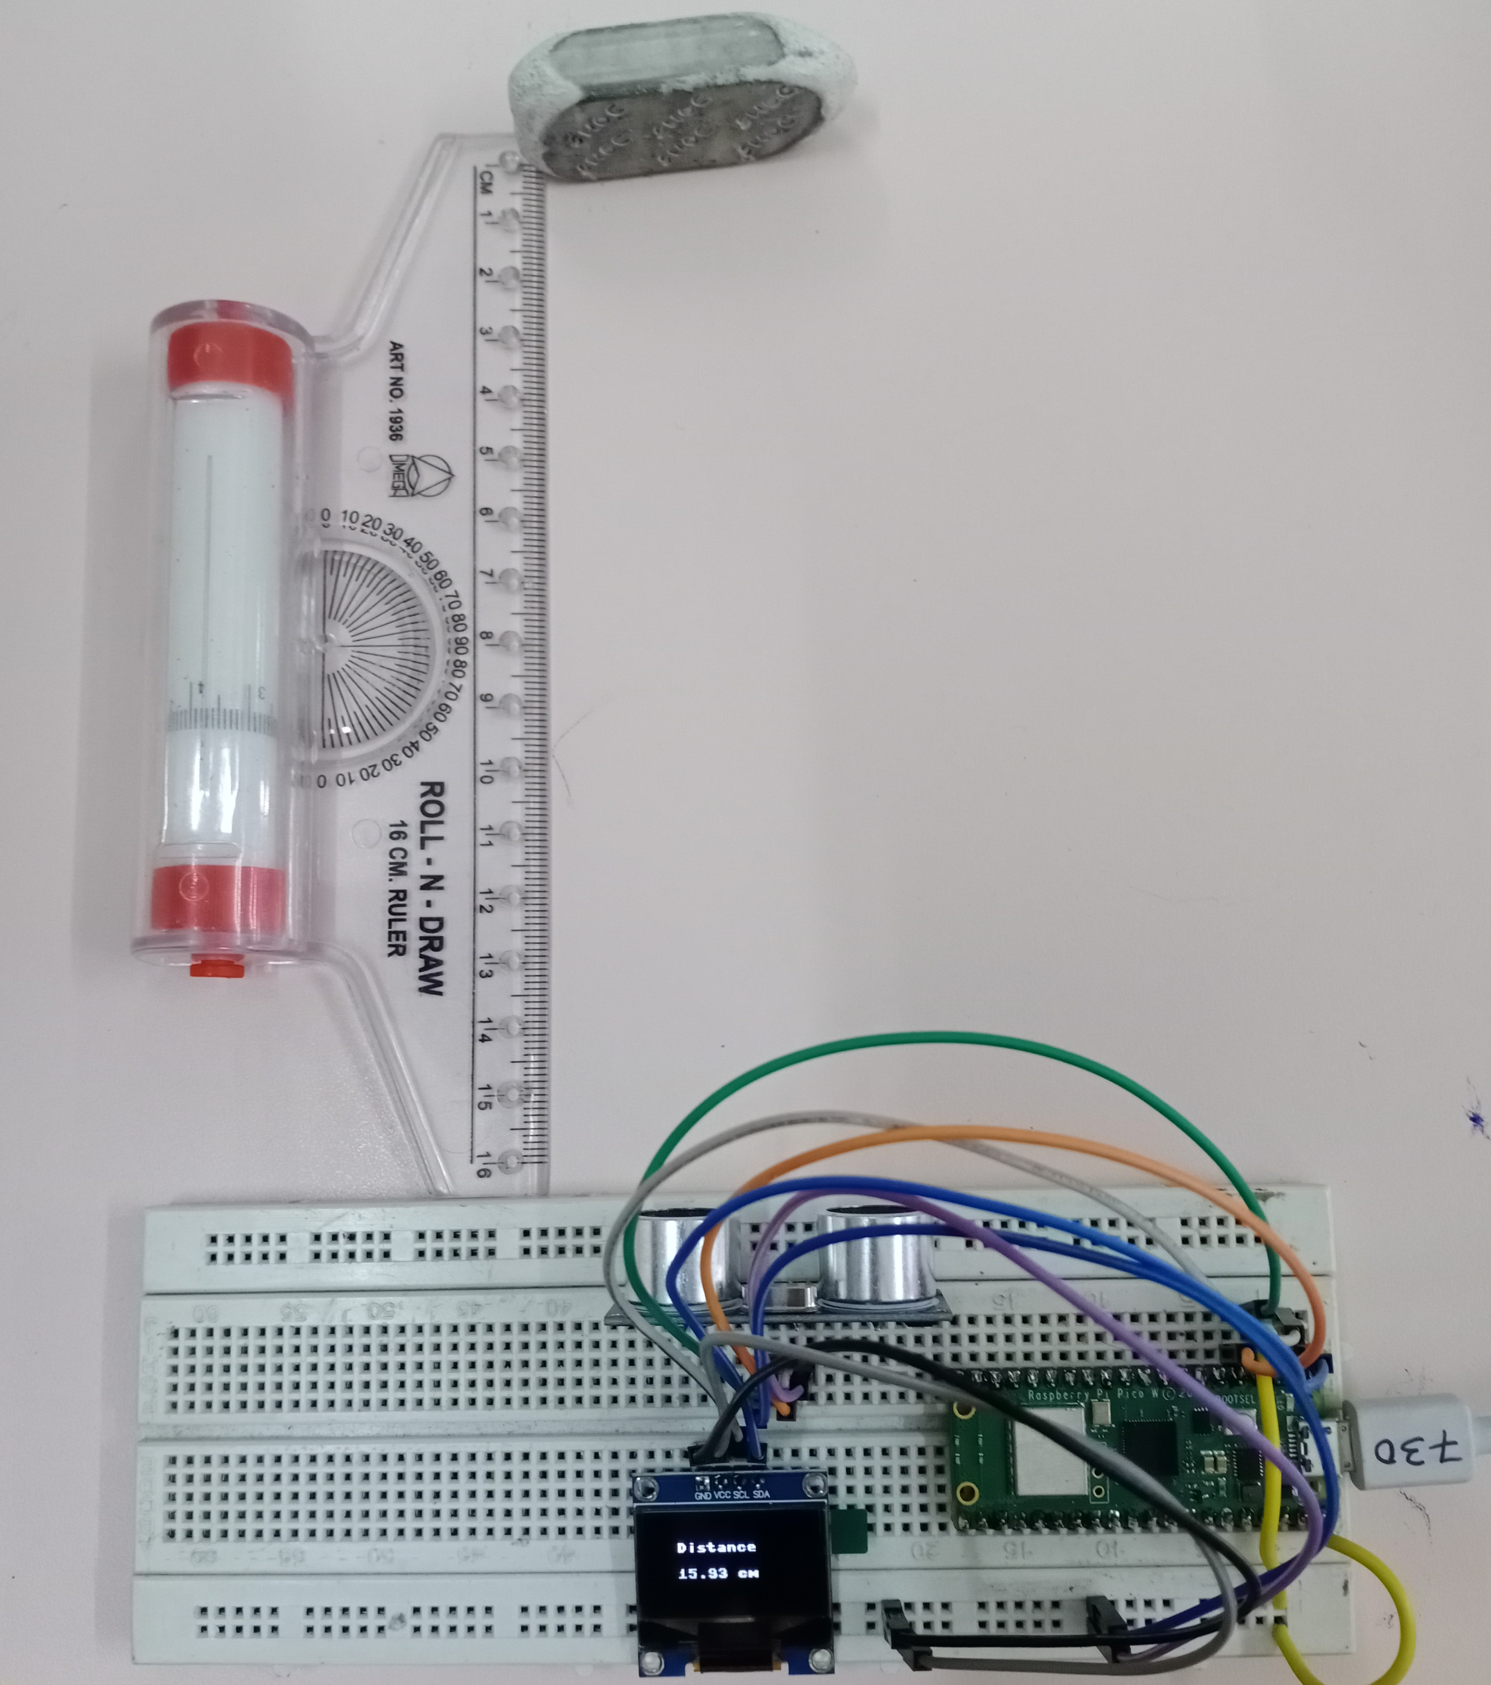
Results
Object at a distance of 16cm

Slide 34
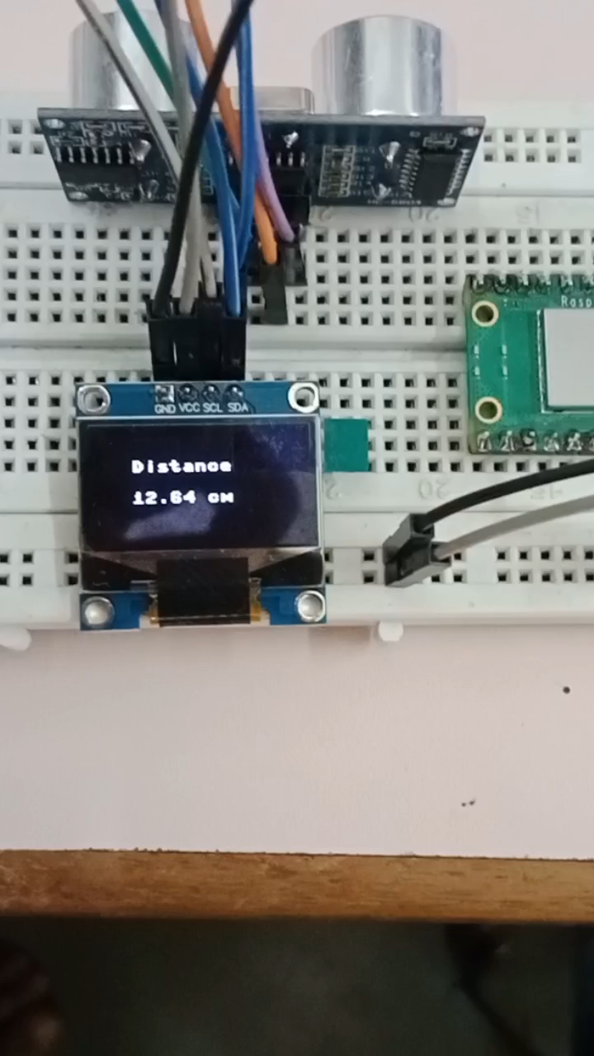
Results
Ultrasonic distance sensor working video

Slide 35
Advantages
The HC-SR04 Ultrasonic Distance Sensor is known for its high accuracy. It can measure distances up to 4 meters with an accuracy of up to 3mm.
The HC-SR04 Ultrasonic Distance Sensor has a fast response time, typically around 20ms.
The sensor is easy to interface with, and requires only a few pins on the microcontroller to operate.
The HC-SR04 Ultrasonic Distance Sensor is a low-cost solution for distance measurement, making it affordable low-budget applications.

Slide 36
Disadvantages
The HC-SR04 Ultrasonic Distance Sensor has a limited range of up to 4 meters.
The HC-SR04 Ultrasonic Distance Sensor may not be sensitive enough to detect very small or low-reflectivity objects. In such cases, another type of sensor, such as a laser distance sensor, may be more suitable.
The HC-SR04 Ultrasonic Distance Sensor has a limited field of view, typically around 15 degrees.
The HC-SR04 Ultrasonic Distance Sensor may be affected by noise in the environment, such as from other ultrasonic sensors or other sources of sound.

Slide 37
Applications
The sensor can be used to detect the presence and distance of objects in close proximity, such as in automatic doors or parking sensors.
The sensor can be used to monitor the movement of people or animals, such as in wildlife research or home security systems.
The sensor can be used for navigation in unmanned aerial vehicles (UAVs), autonomous cars, or other vehicles that require distance measurements.
The sensor can be used to detect the level of liquid or granular materials, such as in tanks or hoppers.

Slide 38
CONCLUSION
Ultrasonic distance sensors use high-frequency sound waves to measure distances, making them useful in many applications, such as robotics, security, and safety. Raspberry Pi, on the other hand, is a low-cost, credit-card-sized computer that is widely used in the field of embedded systems. It is a popular choice for building electronic projects because of its ease of use, flexibility, and powerful processing capabilities.

Slide 39
Future Scope
Real-time monitoring and alerts: A system could be developed such that it monitors the distance sensor readings in real-time and alerts the user if an object comes within a certain distance of the sensor. This could be useful for security or safety applications.
Machine learning: The data collected by the distance sensor can be used to train a machine learning model. This could allow us to make predictions about future distance measurements based on the current environment.
Sports technology: Ultrasonic sensors can be used in sports technology for measuring the speed and trajectory of objects, such as in golf and tennis.
Aviation: Ultrasonic sensors can be used in aviation for detecting and avoiding obstacles during takeoff and landing, with Raspberry Pi Pico providing a low-cost and portable solution.

Slide 40


